Slide 1
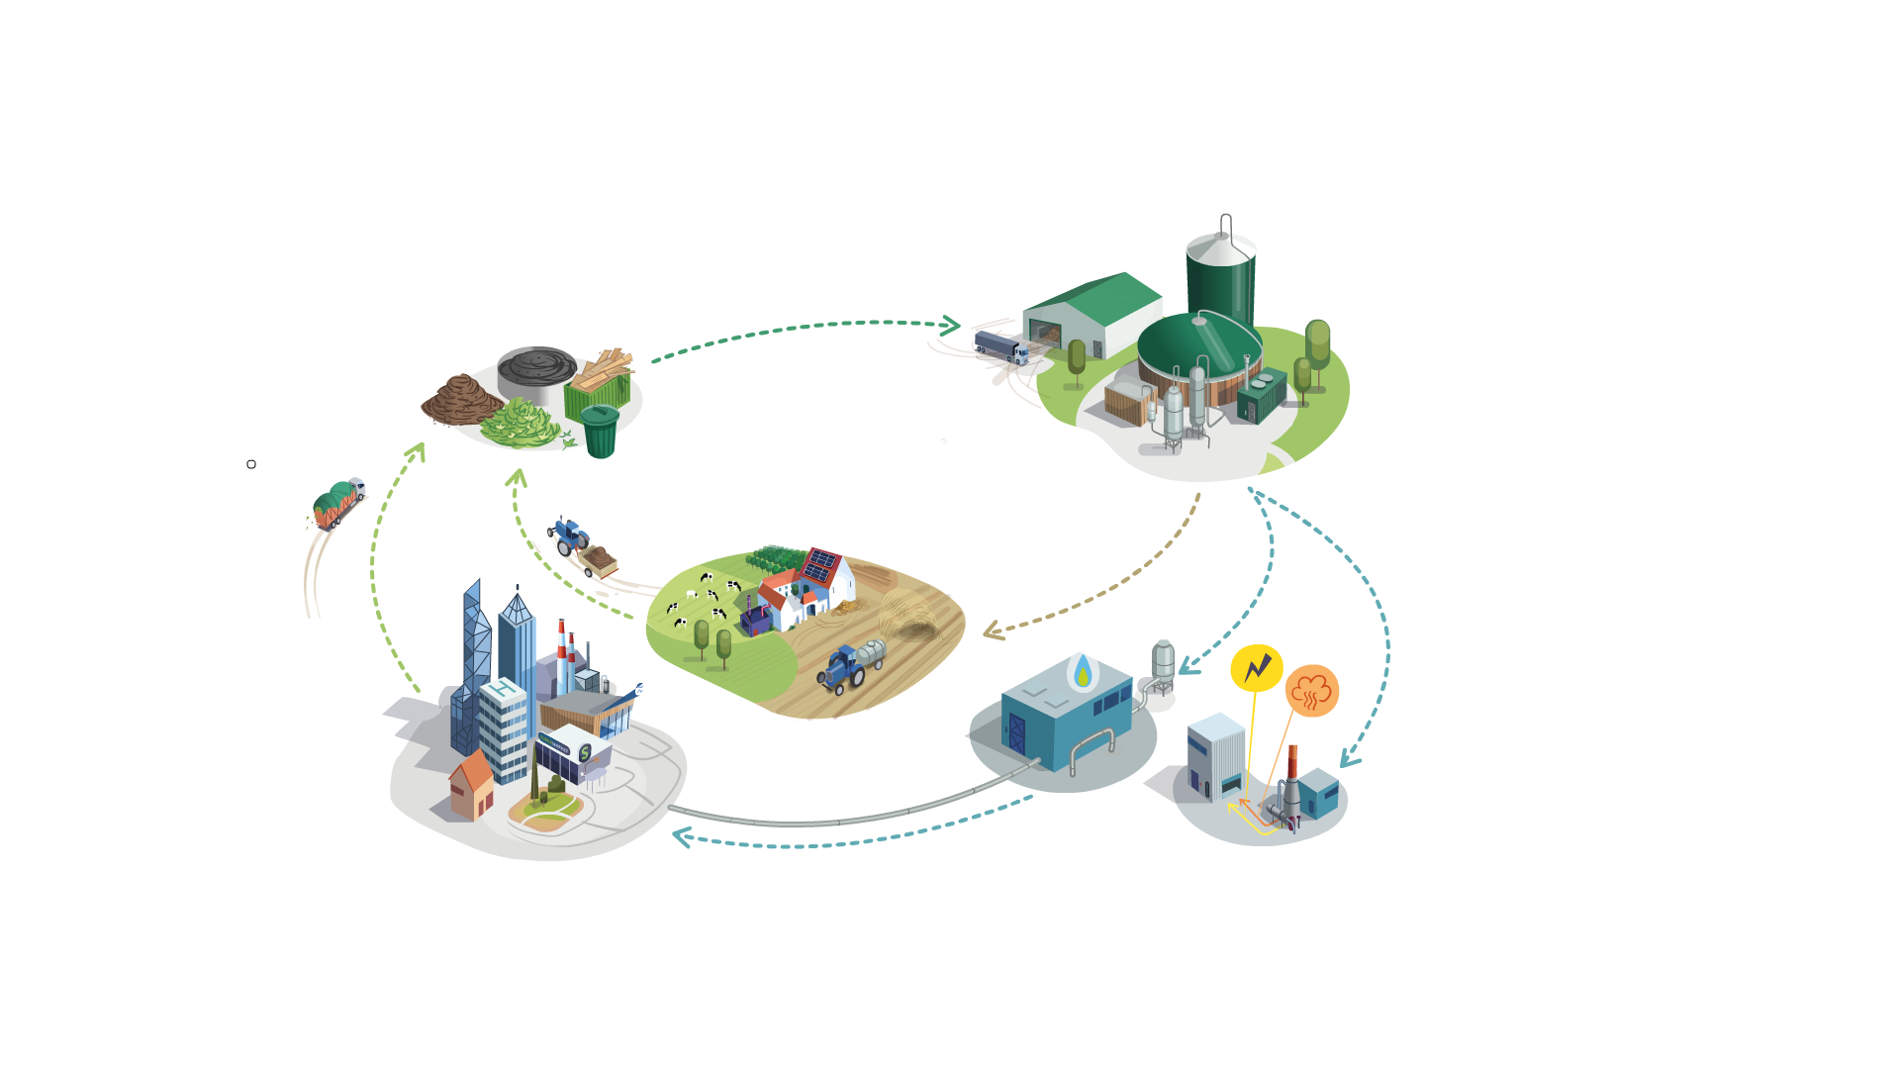



Biomethane, a flexible renewable energy for decarbonization
Local and circular production from sustainable feedstocks
Leveraging the transition
2. Anaerobic fermentation
-80% CO₂ vs natural gas
Independence & Energy security
Local EMPLOYMENT
Sustainable Agriculture & treatment of Waste
Organic agricultural waste is collected and transported to the biogas plant
Organic waste undergoes an anaerobic fermentation process that produces digestate and biogas.
1. Collection
Digestate
Biogas
Used as natural fertilizer
A renewable fuel for generating heat (hot water or steam) and electricity (CHP) on site
1 RGGO = 1 MWh Biomethane injected
Biomethane
3. Upgrading
4. End-use
The biogas is purified so that it can be fed into the gas grid for industrial, mobility, and domestic purposes.
Biogenic CO2

