Slide 1
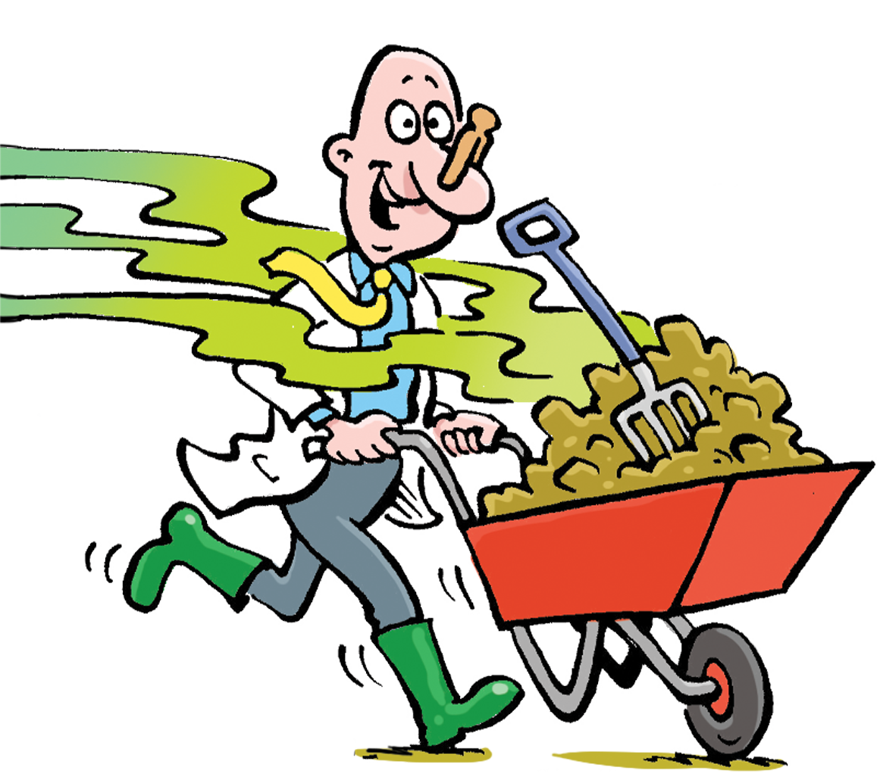

Green Gas
ENGIE Supply UK
Notes:
Intro to the session

Slide 2
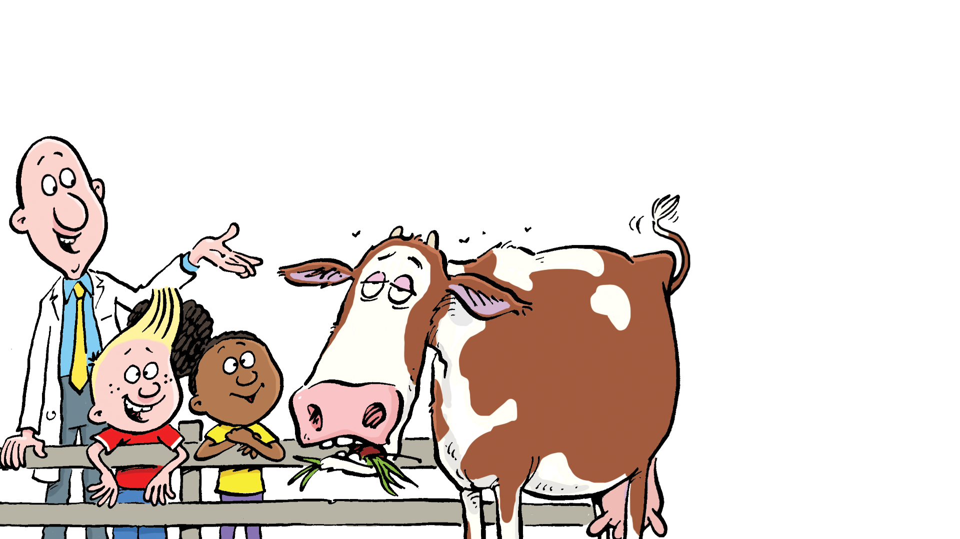
What is Green Gas?
“Green gas is made from plants, food waste, and animal manure. These materials break down and produce gas, which is then cleaned and used for energy. It's a renewable and eco-friendly way to power our homes and schools!”

Slide 3
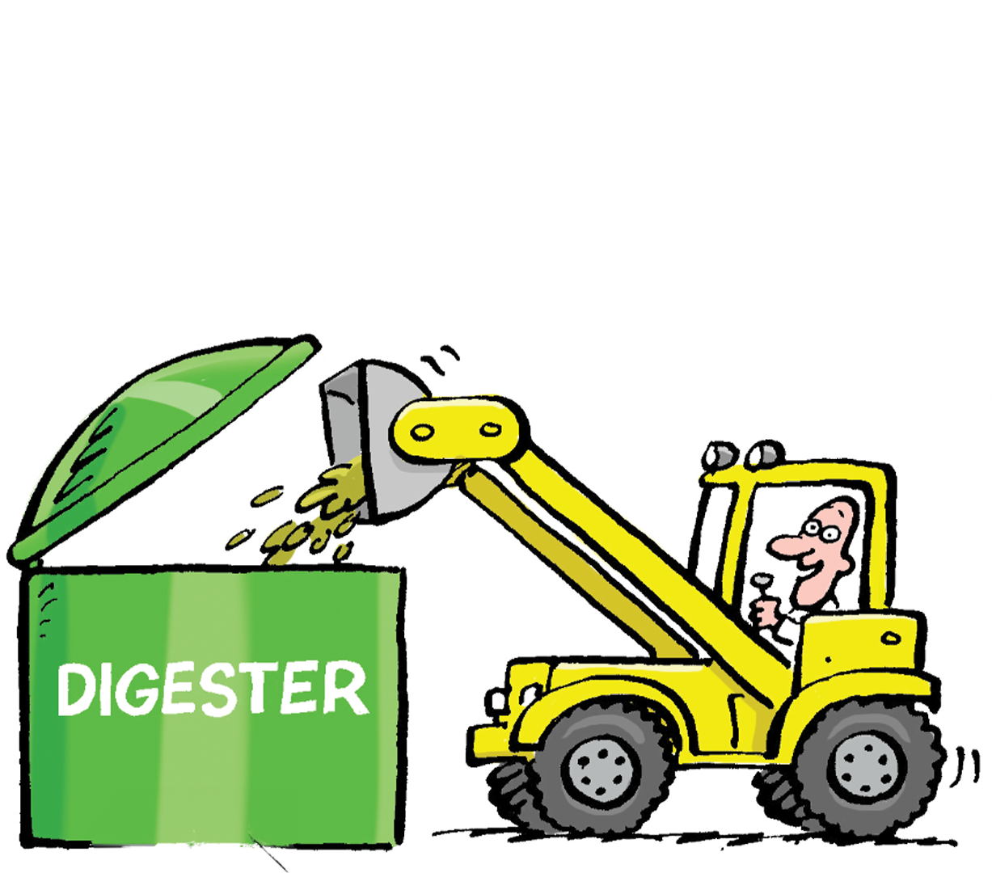
Why is Green
Gas important?
“Green gas is important because it helps reduce pollution and fight climate change. By using waste materials to make energy, we can save natural resources and protect our planet for future generations. It's a smart and sustainable way to power our world!”

Slide 4
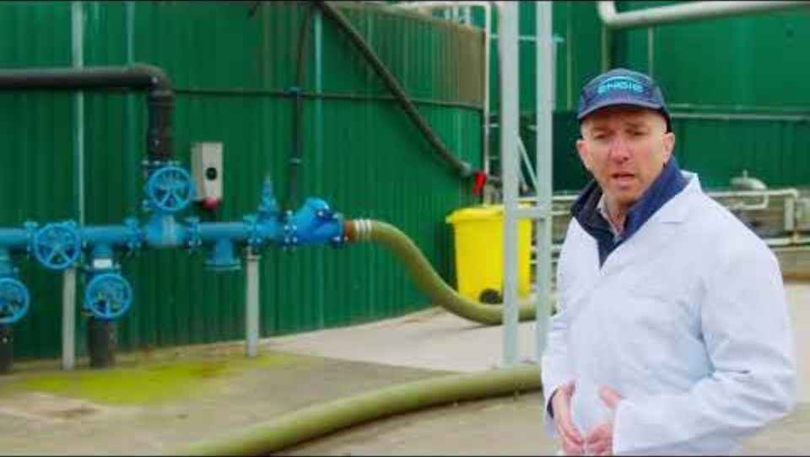
How do we make Green Gas?

Slide 5

Quiz time!
1. Can you name some of the main feed stock that are used to produce gas?
2. How many cows does it take to power a home for a year?
3. What is the waste used from cider production?
4. Where is the feed put in at the start?
5. What temperature is the feed heated up to?
6. How long is it kept I the digester?
7. Where does the feed go at the end of the process?
8. What is the name of the pure gas that’s extracted?
9. What is Doctor Poo’s real name?

Slide 6
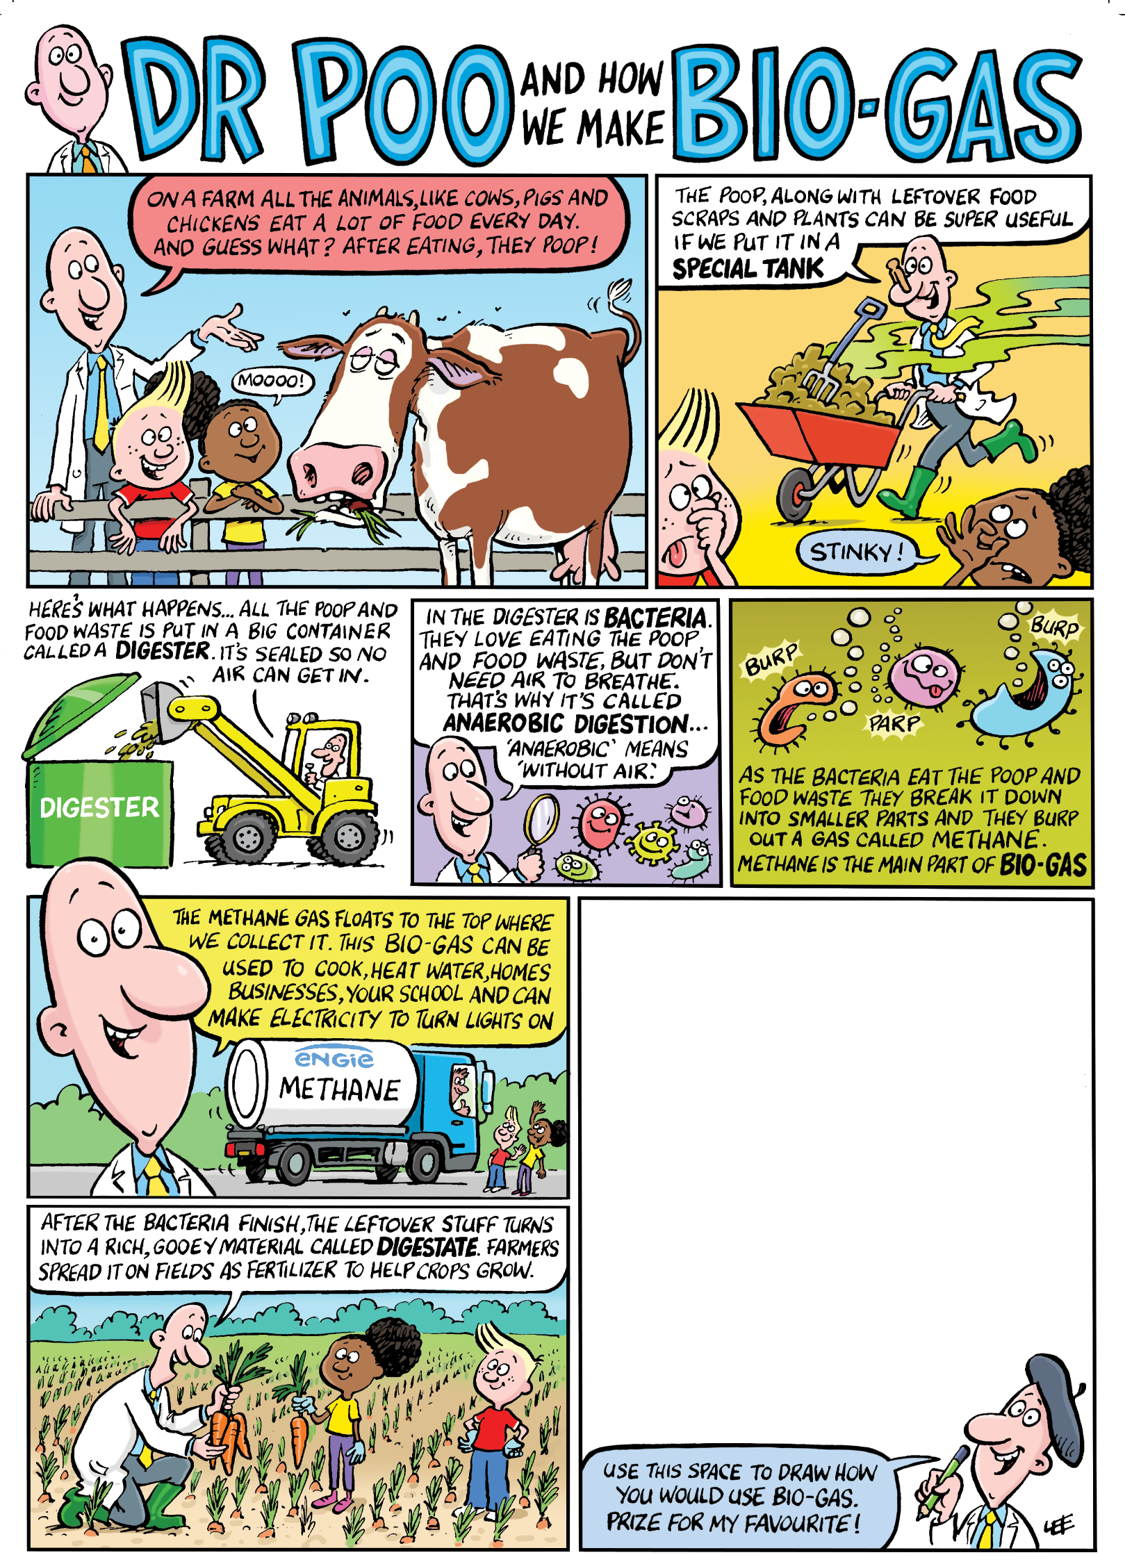

Competition time!

Slide 7
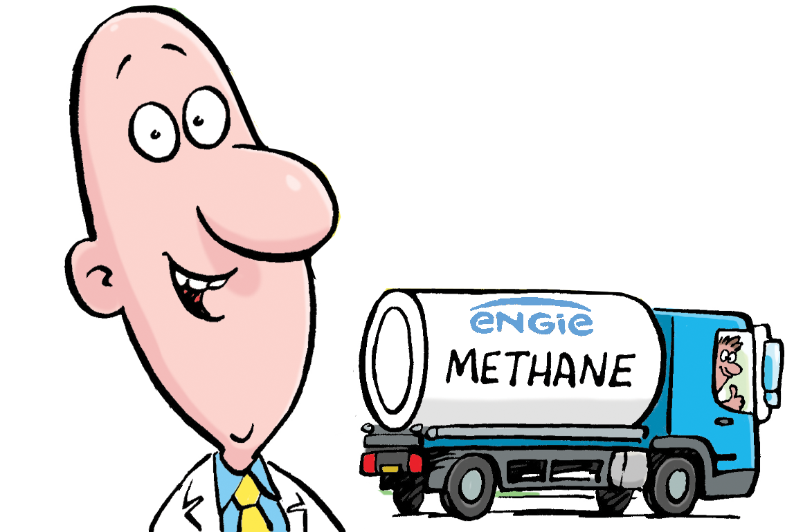
Thank you from
ENGIE Supply UK

